Slide 1


ALLYHUB
A Platform for Developers & Clients

Slide 2

Contents
01
Our Team
02
Reason for Project Selection
03
Goals and Objectives
04
Background Study
05
Requirements Analysis
06
Feasibility Analysis

Slide 3

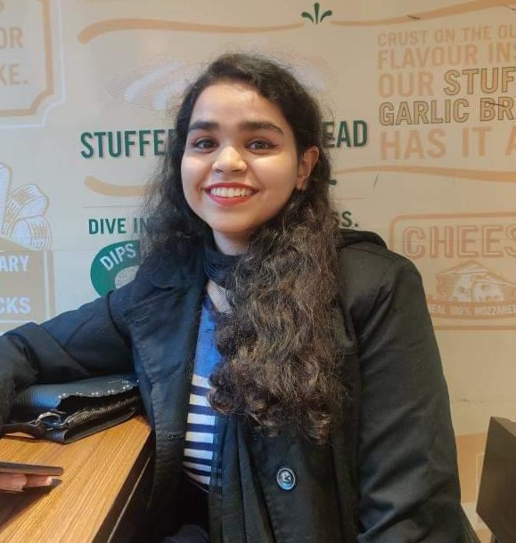
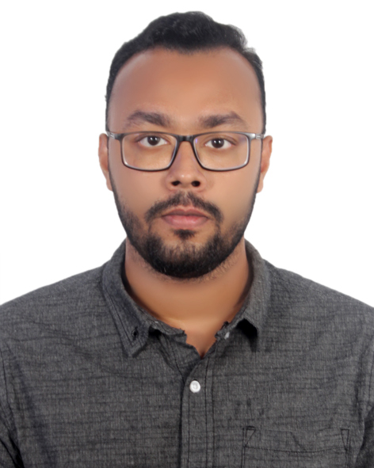


Our Team
Afia Fahmida
Ashikul Islam
Zenun Chowdhury
20210104032
20210104040
20210104047
20210104032

Slide 4


Reasons for Project Selection
Problem Statement
Lack of guidance on finding a potential Team
Lack of regular interaction
No beginner friendly platforms for amateurs and non professionals
Solution
Proper filtration of each personnel
Interactive and smooth platform
Beginner friendly user interface

Slide 5





Goals & Objectives
Flexible Interaction
Collaboration Availability
Experience Growth
Deal Histories
Enables smooth networking easier exploration & interactive collaboration amongst clients and developers.
Helps finding skilled developers for project execution & promote potential team buildup amongst developers.
Offers opportunities for amateurs to acquire hands-on experience and welcomes them into the field of IT.
Stores historical data on completed and successful projects for further inquiries and guarding intellectual property theft

Slide 6



Background Study
In our research background, we explore the current professional networking platforms and pinpoint essential areas that need improvement. Our project is designed to provide a specific solution catering to the distinct requirements of entry-level IT professionals and individuals seeking job opportunities, in contrast to platforms like LinkedIn, Glassdoor etc.
“Ally” refers to friends and “Hub” refers bringing developers and clients to a center so they can work together like allies to bring IT project ideas to life.
AllyHub will
prioritize inclusivity
embrace people from a variety of backgrounds and skill level
Meaning of "AllyHub":
Existing Platforms
Unique Proposition

Slide 7



Requirements Analysis
Functional Requirements
User Authentication
User Panel
Database
Exploration
Posting
Handshake > Handshake Back > Handshaked
Payment Integration
Rating System
Work History

Slide 8
Requirements Analysis
Non Functional Requirements
01
02
03
04
PERFORMANCE
SECURITY
COMPATIBILITY
MAINTENANCE
Responsive interface
Beginner Friendly
Interactive
Data confidentiality
Robust security
Consistency
Various browsers & devices compatible
Proper upgradation
Regular debugging
Taking user reviews into accounts

Slide 9





Feasibility Analysis
Technical Feasibility
Front-End: To guarantee a strong and engaging user experience and smooth integration of different features the platform will be designed with C# programming language and ASP.NET MVC framework.
Back-End: For efficient data storage and retrieval we will be using MySQL server that is capable of handling large volume of data efficiently.
CUSTOMERS

Slide 10


Feasibility Analysis
Operational Feasibility
Easy-to-use experience: The interface will be kept beginner-friendly so that non-IT professionals and freshers can effortlessly navigate and access the proper usage knowledge so that individuals who are not IT experts and novices can easily interact with the platform.
Maintenance of administration: Debugging all new bugs and upgrading it besides keeping the database and security level robust will help in keeping the platform usable.
CUSTOMERS

Slide 11
Feasibility Analysis
Economic Feasibility
Cost of production: Starting expenses for labor in front-end and back-end coding to fulfill functional needs.
Cost of maintenance: Yearly fixed expenses for administrative upkeep to maintain non-functional requirements.
Generating revenue: Initiating projects to generate income, supporting platform upkeep, and exploring expansion possibilities.
CUSTOMERS

Slide 12

STATISTICS
40% of IT novices face unemployment due to their lack of experience.
Increase of 15% per year in the field of IT freelancing.
IT solutions are sought by businesses to enhance operations.
Rate of completion increases when people work together on a project.
Client Satisfaction: More than 80% of clients are happy with entry-level IT professionals.
80%

Slide 13

THANK YOU
Any Queries?

